Slide 1
CH 6
Sorting

Slide 2
Introduction
Sorting is a technique to rearrange the elements of a list in ascending or descending order, which can be numerical, lexicographical, or any user-defined order.
Sorting is a process through which the data is arranged in ascending or descending order
The complexity of a sorting algorithm can be measured in terms of
number of algorithm steps to sort n records
number of comparisons between keys (appropriate when the keys are long character strings)
number of times records must be moved (appropriate when record size is large)
Example:
1, 3, 4, 6, 8, 9 are in increasing order, as every next element is greater than the previous element.
9, 8, 6, 4, 3, 1 are in decreasing order, as every next element is less than the previous element.
9, 8, 6, 3, 3, 1 are in non-increasing order, as every next element is less than or equal to (in case of 3) but not greater than any previous element.
1, 3, 3, 6, 8, 9 are in non-decreasing order, as every next element is greater than or equal to (in case of 3) but not less than the previous one.

Slide 3
Introduction [2]
Sorting algorithms may require some extra space for comparison and temporary storage of few data elements.
These algorithms do not require any extra space and sorting is said to happen in-place, or for example, within the array itself.
This is called in-place sorting.
Bubble sort is an example of in-place sorting.
Sorting which uses equal or more space is called not-in-place sorting.
Merge-sort is an example of not-in-place sorting.
If a sorting algorithm, after sorting the contents, does not change the sequence of similar content in which they annear, it is called stable sorting.
If a sorting algorithm, after sorting the contents, changes the sequence of similar content in which they appear, It is called unstable sorting.

Slide 4
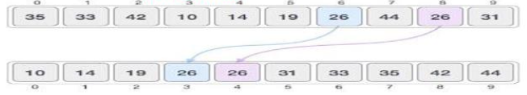
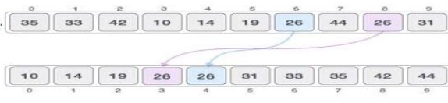
Introduction [3]

Slide 5
Internal vs External Sorting
An internal sort is any data sorting process that takes place entirely within the main memory of a computer.
This is possible whenever the data to be sorted is small enough to all be held in the main memory.
There are 3 types of internal sorts.
(i) SELECTION SORT :- Ex- Selection sort algorithm, Heap Sort algorithm
(ii) INSERTION SORT :- Ex:- Insertion sort algorithm, Shell Sort algorithm
(iii) EXCHANGE SORT :- Ex:- Bubble Sort Algorithm, Quick sort algorithm
Sorting large amount of data requires external or secondary memory. This process uses external memory such as HDD, to store the data which is not fit into the main memory therefore called external sort.
So, primary memory holds the currently being sorted data only. All external sorts are based on process of merging. Different parts of data are sorted separately and merged together.
Ex:- Merge Sort

Slide 6
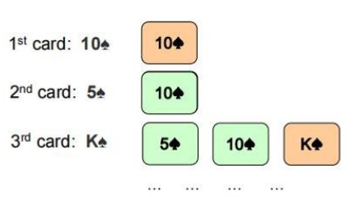
Insertion Sort
Insertion sort is a simple sorting algorithm that works similar to the way you sort playing cards in your hands.
The array is virtually split into a sorted and an unsorted part.
Values from the unsorted part are picked and placed at the correct position in the sorted part.

Slide 7
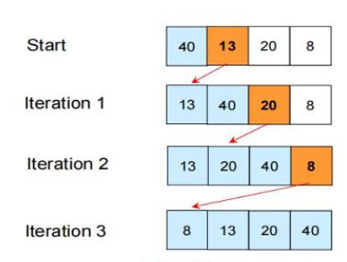
Insertion Sort Algorithm
We start with an empty left hand [sorted array] and the cards face down on the table [unsorted array]
Then remove one card at a time from the table [unsorted array], and insert it into the correct position in the left hand [sorted array].
To find the correct position for the card, we compare it with each of the cards already in the hand, from right to left.

Slide 8
Insertion Sort Algorithm

Slide 9
Insertion Sort - Implementation
void insertionSort(int a[],int n){
for(int i=1;i<n;i++){
Int next = a[i];
for(int j=i-1;j>=0 && a[j]>next ; j--)
a[j+1]=a[j];
a[j+1] = next;
}
}

Slide 10
Insertion Sort - Implementation
Input: 9,1,3,2,7,6,5,8,0
next | i | j | array
1 | 1 | 0, | 1,9, 3,2,7,6,5,8,0
3 | 2 | 1, 0 | 1,3,9, 2,7,6,5,8,0
2 | 3 | 2, 1 | 1,2,3,9, 7,6,5,8,0
7 | 4 | 3, | 1,2,3,7,9, 6,5,8,0
6 | 5 | 4,3 | 1,2,3,6,7,9, 5,8,0
5 | 6 | 5,4,3 | 1,2,3,5,6,7,9, 8,0
8 | 7 | 6, | 1,2,3,5,6,7,8,9, 0
0 | 8 | 7,6,5,4,3,2,1,0 | 0,1,2,3,5,6,7,8,9

Slide 11
Insertion Sort - Analysis
The Outer loop executes (n-1) times
Number of times, the inner loop executes depends on the input
Best Case: the array is already sorted and (a[j]>next) is always false. No shifting of data is necessary in that case.
Worst Case: The array is sorted in reverse order and (a[j]>next) is always true.
Average case: The data is mixed and sometimes shifting of data need to be done.
So the Big O of insertion sort is given as:
Best case time is O(n)
Worst case time is O(n²)
Average case time is O(n²)

Slide 12
Assignment
Trace the insertion sort algorithm for sorting the following list of elements in ascending order:
{0,1,2,3,4,5,6,7,8,9}
{9,8,7,6,5,4,3,2,1,0}
{0,9,1,8,2,7,3,6,4,5}

Slide 13
Selection Sort
Sort an array by repeatedly finding the minimum element (assuming ascending order) from unsorted part and putting it at the beginning.
Algorithm
Find the min value in the array
Swap it with the value in the first position
Repeat this process for all the elements until the entire array is sorted.

Slide 14
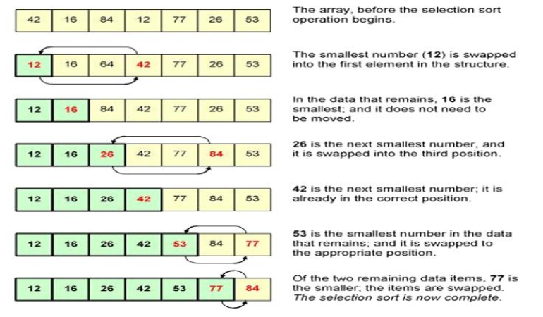
Selection sort [2]

Slide 15
Selection Sort [3]

Slide 16
Selection sort Analysis
Selection of the lowest element requires scanning all n elements. This will take (n-1) comparisons.
Swapping it into the first position.
Finding the next lowest element requires scanning remaining n-1 elements and so on, therefore it will take comparisons as=> (n-1)+(n-2)+ … + 2 + 1 comparisons ie: O(n²) comparisons.
At every loop, it requires swapping of 1 swap for n-1 elements.
Therefore:
Worst case performance: O(n²).
Best case performance: O(n²).
Average case performance: O(n²).

Slide 17
Assignment
Trace the selection sort algorithm for sorting the following list of elements in ascending order:
{0,1,2,3,4,5,6,7,8,9}
{9,8,7,6,5,4,3,2,1,0}
{0,9,1,8,2,7,3,6,4,5}

Slide 18
Bubble Sort
Repeatedly swap the adjacent elements if they are in the wrong order.
Algorithm
Compare each pair of adjacent elements in the array containing n elements.
Swap two elements if necessary
Repeat this process for all elements until the entire array is sorted.
Reduce n by 1 and go to step 1.

Slide 19
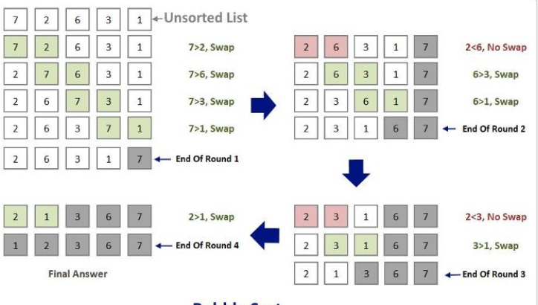
Bubble Sort [2]

Slide 20
Bubble Sort [3]

Slide 21
Bubble sort[4]
Trace the selection sort algorithm for sorting the following list of elements in ascending order:
{0,1,2,3,4,5,6,7,8,9}
{9,8,7,6,5,4,3,2,1,0}
{0,9,1,8,2,7,3,6,4,5}

Slide 22
Bubble Sort Analysis
Outer loop requires n iterations
A single iteration of the inner loop requires time bounded by the constant c.
Inner loop
When i=0, requires n-1 iterations
When i=1, requires n-2 iterations
When i=n-1, requires 0 iterations.
So, the total number of iterations = 0+1+ … + (n-1) = n(n-1)/2
Total time = c*n(n-1)/2 = O(n²).
Worst case and average case complexity is O(n²)
best case it is O(n²)

Slide 23
Shell Sort
Shell sort is a generalized version of the insertion sort algorithm.
It first sorts elements that are far apart from each other and successively reduces the interval between the elements to be sorted.
The interval between the elements is reduced based on the sequence used.
Compare elements in the array that are separated by a gap of >1 indexes.
Makes multiple passes through the array and sorts a number of equally sized sets using insertion sort.
Algorithm
Initialize the gap size (N/2, N/4, ...1)
Divide the array into subarrays of equal gap size
Apply insertion sort on the subarrays.
Repeat the above steps by decreasing the gap size until the gap size becomes 0 resulting into a sorted array.

Slide 24
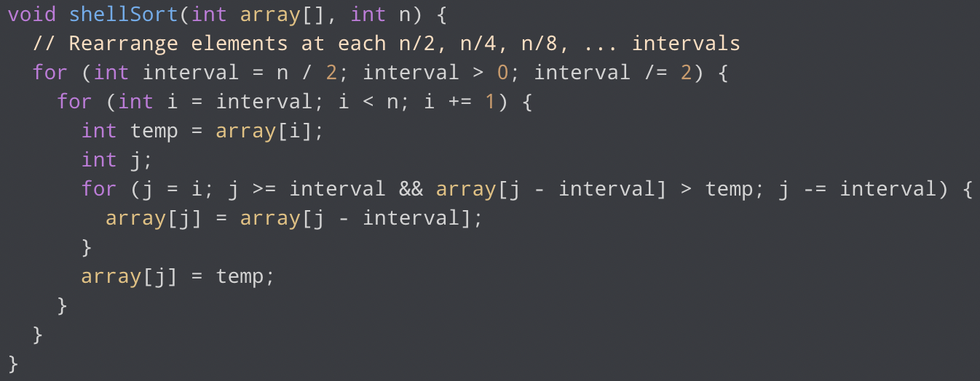
Shell Sort - Implementation

Slide 25






Shell Sort - example
Consider an unsorted array: 81 94 11 96 12 35 17 95 28 58
n=10, consider gap as k=5 [10/2] [81 94 11 96 12] [35 17 95 28 58] First pass: [35 17 11 28 12 81 94 95 96 58]
In second pass, K is reduced to 3 [10/4] [35 17 11] [28 12 81] [94 95 96] [58] Result: [28 12 11 35 17 81 58 95 96 94]
In third pass, K is reduced to 1 [10/8] [28] [12] [11] [35] [17] [81] [58] [95] [96] [94] Result: [11 12 17 28 35 58 81 94 95 96]

Slide 26
Shell Sort - Analysis
Best Case = 0(nLogn)
Average Case = 0(nlogn)
Worst Case = O(n²)

